Slide 1
Statistical Analysis
Topic: Dot Plots
EQ: What is a dot plot and why do we use them to display data?

Slide 2
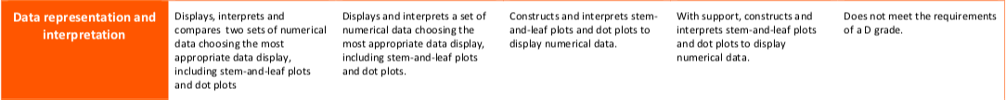
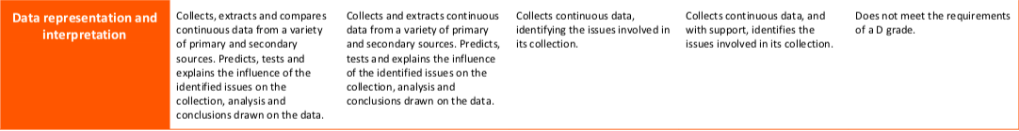

The Judging Standards for this unit (aka - How You will be Assessed!)

Slide 3
Starter Activity – To be done in the classroom if space permits, or in the hallway/outside with chalk
Wherever you are, mark a number line out (with tape, chalk, etc...), close to or on the ground, over a significant distance (ex – half the width of a classroom)
Number the intervals 1-12
Have students arrange themselves in the number that corresponds with their birth month ( 1- Jan, 2 – Feb, 3 – Mar, etc...)
What type of graph might this be?
Notes:
Teacher notes: Students are creating a human dot plot with the numbers 1-12 representing the months of the year. A little practical pre-activity that introduces them to what they’re about to create on paper.
You can do this survey with anything else you might want (instagram followers, favourite colours, etc...)

Slide 4
Dot Plots EQ: What are dot plots and why do we use them to display data?
Summary:

Slide 5
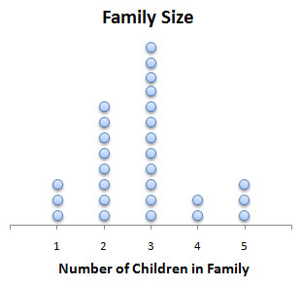
Dot Plots EQ: What are dot plots and why do we use them to display data?
Displaying a data allows reader easily see the patterns in the data. Data can be displayed in dot plots, column plots, picture graphs etc.
What are dot plots?
Dot plots are constructed by putting a dot for each data item above a scale.
Each dot represents one data value.
How many families have 2 children?
What is the most common number of children in a family?
How many people were surveyed?
8
3
28

Slide 6
Dot Plots EQ: What are dot plots and why do we use them to display data?
How do I create a dot plot?
Example 1:
The following list shows ages of the students in the group:
12, 12, 13, 12, 12, 11, 12, 11, 12, 12, 11, 11, 12, 13, 12
Process:
Step 1 : Draw a number line from the lowest value to highest value. Leave room able the scale for the dots.
Step 2: Put dots for each number on the scale.
Step 3 : Label the number line
11
12
13
Age

Slide 7
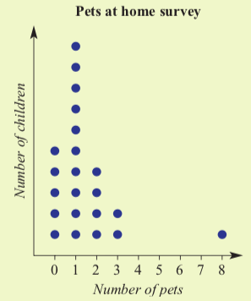
Example 2 – Interpreting Dot plots
The following dot plot shows the results of a survey that asked students how many pets the have at home:
Use this graph to state how many children have 2 pets
How many students participated in this survey?
What is the range of values?
What is the median number of pets?
What is the mode?
- There are 4 dots in the ‘2 pets’ category, so 4 students have 2 pets
- The total number of dots is 22.
- Range = highest – lowest. In this case, highest = 8, lowest = 0. 8-0 = 8
As there are 22 children, there are 2 median values, the 11th and 12th values. In this case, the 11th and 12th values are both 1, so the median is 1.
- 1. Most children have 1 pet.
Notes:
Guide students through the question.
Option 2: Dot plots handout (Scaffolded for kids who may need extra help)

Slide 8
Independent Practice
Roll the dice Dot Plot game in pairs/groups
Application: Once you’ve completed your frequency table and Dot plot, calculate the following for your sample space:
The Median
The Mode
The Range
Extension:
How many times did you roll a multiple of 2?
What is the mean number you rolled?

Slide 9
Class/Homework
Dot Plot Worksheet or Statistics Foldable
Notes:
The Statistics Foldable works with both dot plots and histograms, so may be good to start now and add on to once we get to histograms. Or just wait until histograms, your call, Teach.

Slide 10
Exit Pass
6, 6, 2, 5, 7, 3, 2, 2, 1, 4
On a piece of paper, create a dot plot for above set of numbers.
Calculate the mean, median, mode and range for the above set of numbers
Hand in to me when done and complete summary

Slide 11
Measures of Center and Spread EQ: What are mode and range and what do they tell us about a data set?
Complete your summary by answering the EQ
Summary:

Slide 12
Homework
Review Notes
List all new terms in glossary
Finish Dot Plot worksheet or Statistics Foldable

